Slide 1

TRAVEL BUDDY
Team Members:
Sai Srikar Miriyala Sowmya Reddy Allugari Lakshmi Pravallika Bhupathi Nishchala Namburi Yaswanth Kanakala Udaykiranreddy Devarapally

Slide 2
Project Outline:
Introduction
Problem Statement
Proposed Solution
Functional Requirements
Non-Functional Requirements
Use Cases/User Stories
Data Management Plan
Conclusion

Slide 3
Introduction:
Comprehensive travel planning and itinerary management application.
Simplifies the process of organizing trips and discovering attractions.
Suitable for both weekend getaways and month-long adventures.
Seamlessly integrates trip planning, booking, and exploration.
Provides a seamless and enjoyable travel experience

Slide 4
Problem Statement:
Challenges & Inefficiencies
Lack of Centralized Platform
Inadequate Destination Guides
Absence of Real-time Booking Integration
Issues with Offline Functionality
Impact on Traveler Experience

Slide 5
Proposed Solution:
User Centric Design
Comprehensive Trip Planning
Secure Booking and Payment System
Personalized Recommendations
Robust Data Management

Slide 6
Functional Requirements:
Non-Functional Requirements:
User Registration & Profiles
Planning Tools: Destinations, Dates, Flights
Interactive Maps & Itinerary Creation
Detailed Flight Guides: Destinations, Airlines
Real-Time Booking & Payment Integration
Calendar View for Schedules
Secure Data Storage: Preferences, Reservations
Intuitive User Interface
Search & Filter Functionality
Robust Performance
Intuitive Interface
Cross-Platform Compatibility
Modular & Well-Documented Code
Code Quality & Stability
Secure Data
Optimal Device Performance

Slide 7
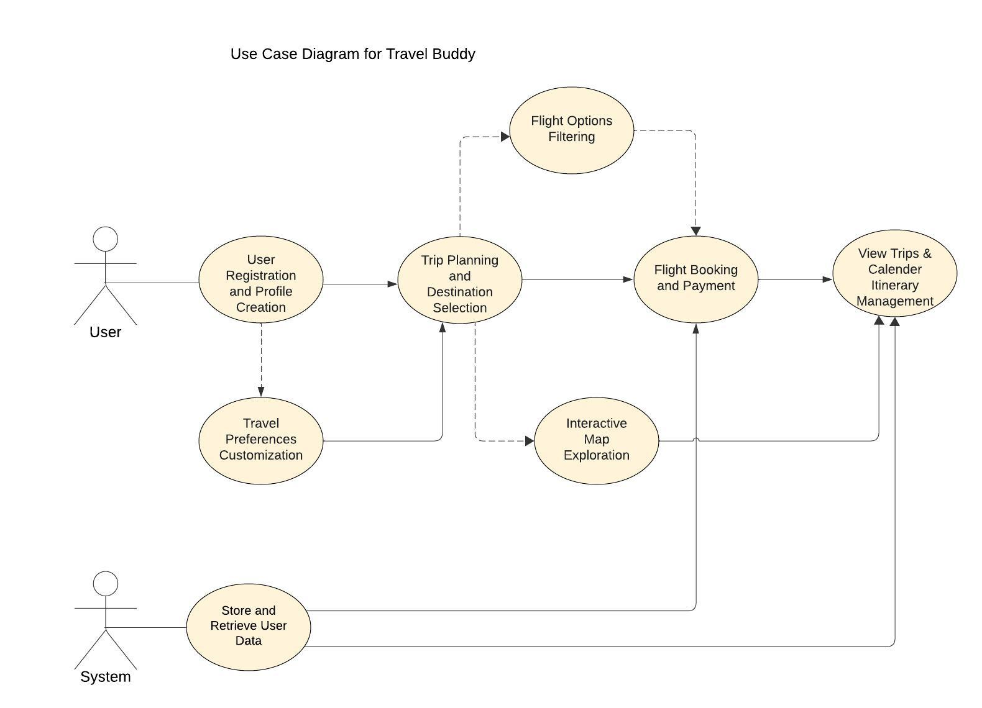
Use Cases:

Slide 8
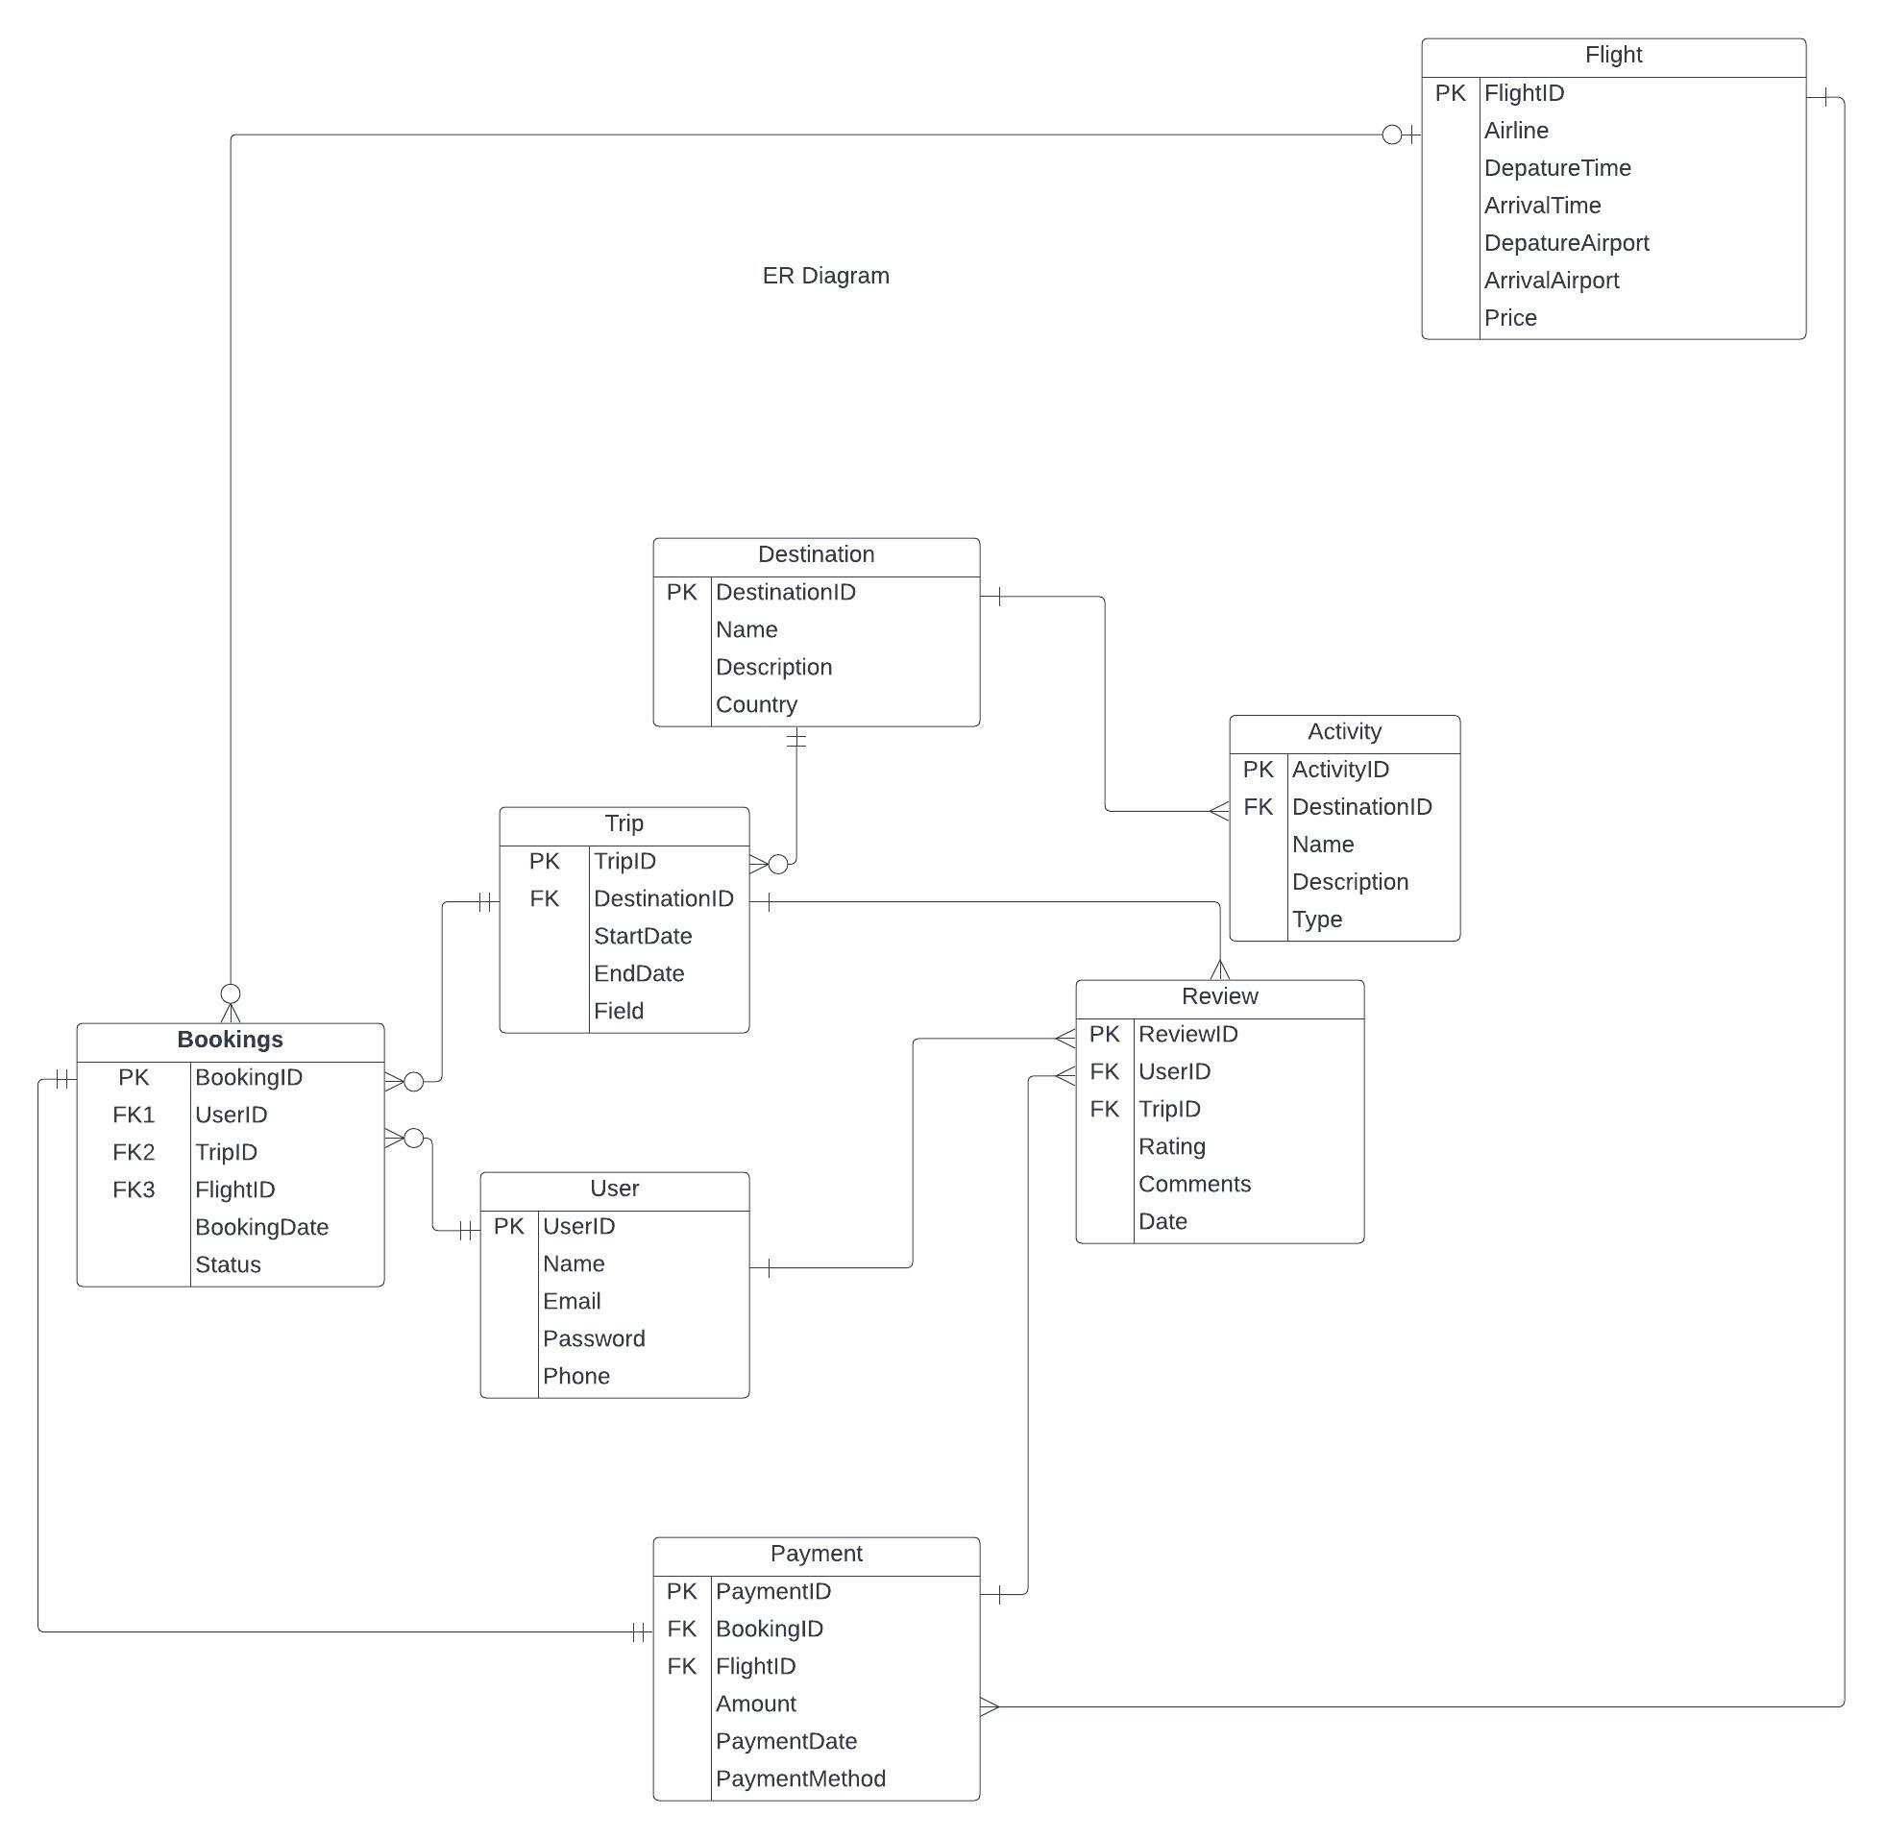
Data Management Plan:
Comprehensive storage of essential data entities: user profiles, destinations, trips, bookings, flights, activities, reviews, and payments.

Slide 9
Conclusion
What have been accomplished?
Lessons Learnt:
Efficient resource management within budget and timeline constraints is crucial for project success.
Adhering to regulations and app store guidelines is essential for successful deployment.
Continuous improvement based on user feedback requires collaboration and communication among team members.
Implementing TravelBuddy will revolutionize the travel planning experience, significantly enhancing efficiency and convenience.
By offering a centralized platform for trip planning, and discovering attractions, TravelBuddy will streamline the entire travel process.
Addressing current operational challenges, this system will greatly improve user satisfaction and elevate the overall quality of travel planning, making it more accessible and enjoyable for travelers.

Slide 10

!

